Slide 1
Assessment of the Utility of Image Enhancement For Underwater Tasks
ROB: 8760 Capstone Project
Submitted by - Amitabha Deb
Advisor - Junaed Sattar

Slide 2
Introduction
Underwater images appears bluish and blurry.
Recently, learning-based methods provide state-of-the-art performance in approximating the underlying mapping to enhance the quality of images
These image enhancement models are often computationally heavy
Excess energy expenditure, induces noise to undistorted images.

Slide 3
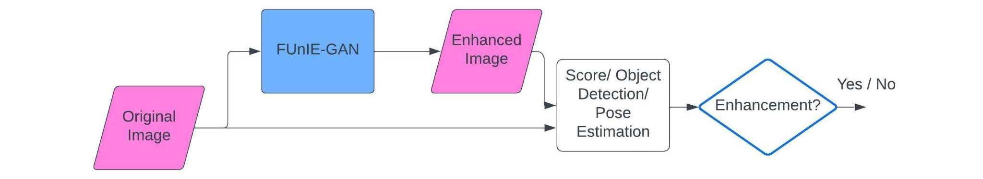
Methodology
We attempt to determine when to use these image enhancement filters
Based on the specific tasks undertaken by underwater robots
Label 0 - no enhancement is needed Label 1- enhancement is needed

Slide 4
Methodology
Collecting underwater images for various tasks and conditions
Getting enhanced images for these tasks using FUnIE-GAN
Inference on both original and enhanced images
Creating a dataset from success and failure
Design a deep learning architecture to learn the patterns

Slide 5
Collecting Underwater Images for Various Tasks and Conditions
Trashcan dataset
Common Objects Underwater (COU) - ’cup’ class
New diver pose dataset

Slide 6
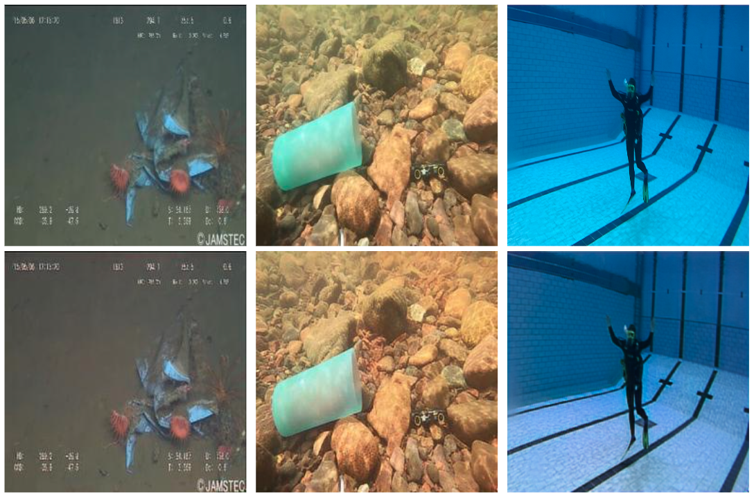
Getting Enhanced Images for these Tasks Using FUnIE-GAN
FUnIE-GAN was employed to generate enhanced images
FUnIE-GAN has an output size of 256 x 256
The input images are also resized to 256 x 256 pixels
Original Images
Enhanced Images

Slide 7
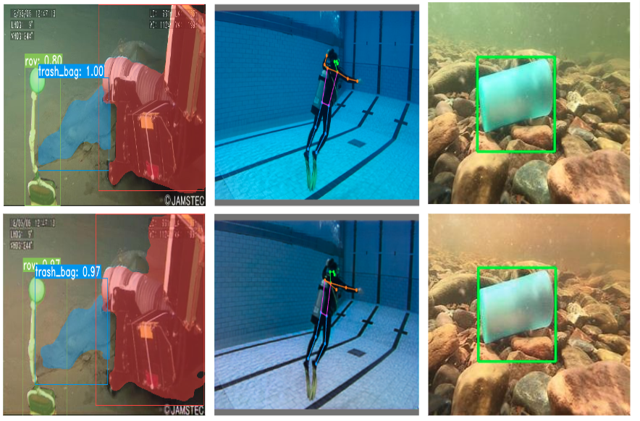
Inference on Both Original and Enhanced Images
YOLACT model on the Trashcan dataset
YOLACT model has been trained on the original images
Yolo-v8 on COU-Cups
Only lake images and was also not suitable for FUnIE-GAN
Yolo-v7 on new Diver Pose Dataset
Enhancement adds unnecessary noise to the image
Fig: Detections on original (top row) and enhanced (bottom row) images for Trash- can (leftmost column), diver pose dataset (middle column), and COU ’cups’ (right column).

Slide 8
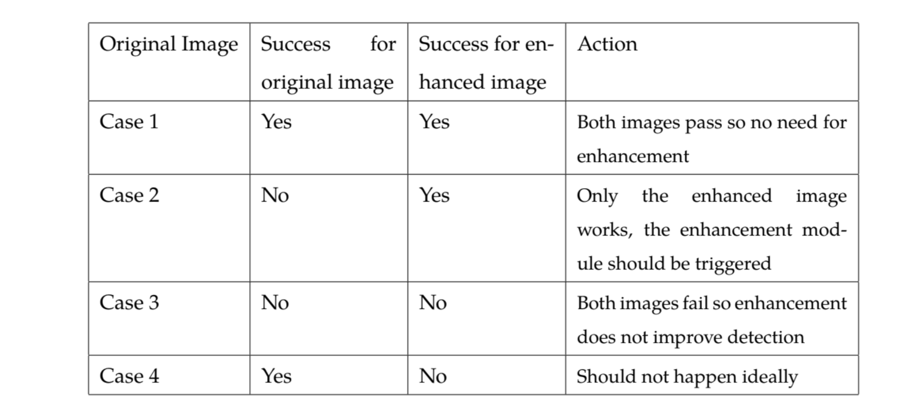
Creating a Dataset from Success and Failure
The fitness of these bounding boxes as a measure of success
IoU of the bounding boxes are measured
The labels have been generated as ’1’ when the improvement in IoU score is more than 10%

Slide 9
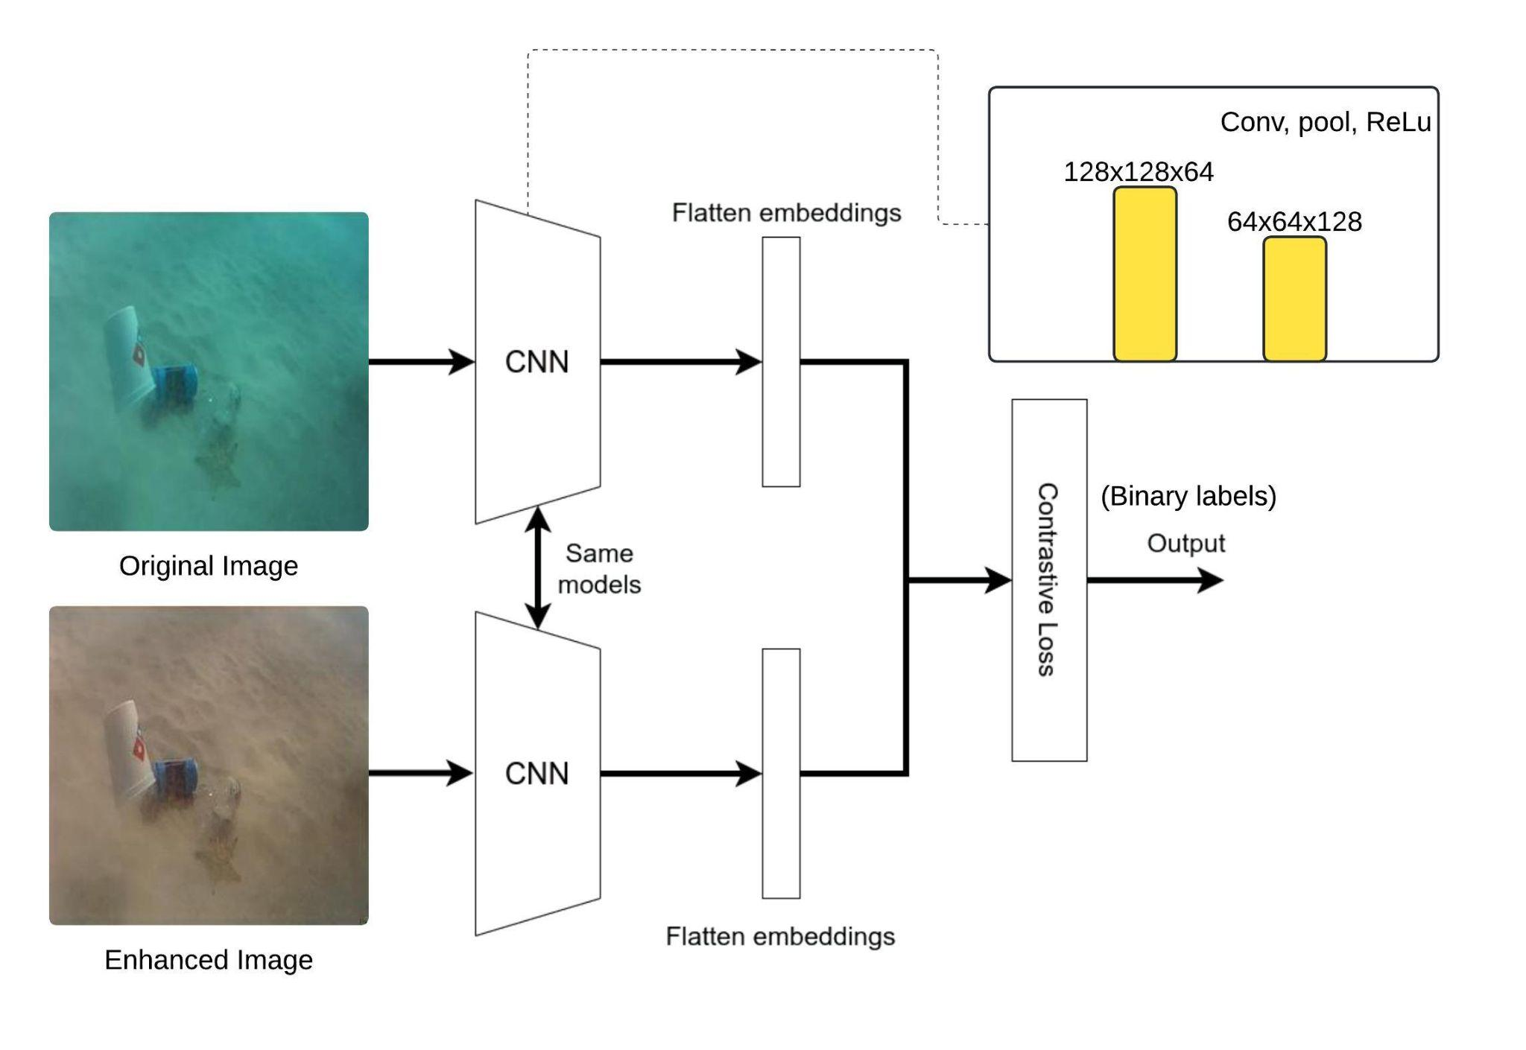
Design a Deep Learning Architecture to Learn the Patterns
ResNet-18 model with 18 layers
weighted cross-entropy loss function
test f1 score of 0.51, which can be attributed to the quality of the labels generated
Siamese based Network
to learn the difference between the image pair
Limitations in translating this model to a single input model
test f1 score of 0.62

Slide 10
Results
• FUnIE-GAN’s performance in enhancing underwater images is constrained due to training set limitations.
• Visual analysis reveals inconsistencies in image quality.
• Detection analysis demonstrates that enhancements do not significantly benefit object detection and pose estimation tasks, potentially due to noise introduced by FUnIE-GAN.
• Classification results show limited success, with minor improvements observed in prediction performance.

Slide 11
Conclusion
Task-based approaches for image quality enhancement have not been explored much previously. This approach is more practical as different tasks need different quality images to be effective.
We see that the major limiting factor has been our training set for the enhancement algorithm as well as the detectors. In the future, this can be addressed by creating a dataset specialized for this workflow.
Lastly, we should consider training an image enhancement model with a larger output size so that we obtain a higher resolution enhanced image.

Slide 12
Thank You

